Slide 1

Converging Communities
Presented for the Colorado Association for Developmental Education
by
Hunter R. Boylan, Ph.D.
Professor and Director, NCDE

Slide 2
There are two key phrases in this definition…
Integration of courses and services, and
Principles of adult learning and development.

Slide 3
Developmental Education is…
“The integration of courses and support services guided by the principles of adult learning and development”

Slide 4
What is a philosophy?
A philosophy is a set of beliefs about what is true. A philosophy undergirds values and guide actions.

Slide 5
The basic philosophy of developmental education is…
We accept students where they are and we move them as far as they can go.

Slide 6
Basic principles of adult development…
Adults learn by connecting new information to what they already know.
Adults value information that has relevance to their lives.
Adults like to be partners in the learning process.

Slide 7
Basic principles of adult development…
Adults like to have a variety of learning activities.
Adults need to be respected.
Adults require feedback and constructive criticism.

Slide 8
Basic Principles of Adult Development…
Adults’ affective development is connected to their cognitive development.
Adults need to be responsible for their own learning.
Adults like to know the details of a given learning process.

Slide 9
Vincent Tinto points out that…
Most community college students spend only the amount of time on campus it takes to attend classes. That is the only time we have to make a difference.
We increase the power of that difference making through integrated courses and services.

Slide 10
Integration On Campus
Recognize that it takes all the resources available to promote student success.
Know your own goals and objectives.
Identify the goals and objectives of others.
Find commonalities among goals and objectives.

Slide 11
Who Are Our Collaborators?
Financial Aid Office
Learning Commons
Advising and Testing
ACCESSibility Services
Student Activities Program
Retention Services

Slide 12
Identify where your goals and theirs intersect.
What values do you share?
How can you improve communication between you and your colleagues?
How can your courses and services complement each other?

Slide 13
What is Your Message to Colleagues?
Our job is to accept students where they are and move them as far as they can go.
Everyone is responsible for student success.
Affective development is as important as cognitive development.

Slide 14
What is Your Message to Students?
College is different from high school.
You are responsible for everything that takes place in class whether you are there or not.
If you take advantage of the opportunity and support available here, you will be successful.

Slide 15
Factors Influencing Student Success for the Typical Student

Slide 16
Factors Influencing Student Success for the Underprepared Student

Slide 17
The weaker the student the more important are…
Quality of instruction, and
Students’ personal beliefs, values, and attitudes about learning.

Slide 18
Beliefs and values are influenced by…
Life events outside of college,
The experience inside of college, and
The lessons of those events and experiences.

Slide 19
We cannot control students’ life events but we can control…
How we respond to those events,
How we help students learn from the experience of those events,
How supportive students perceive us to be in responding to those events.

Slide 20
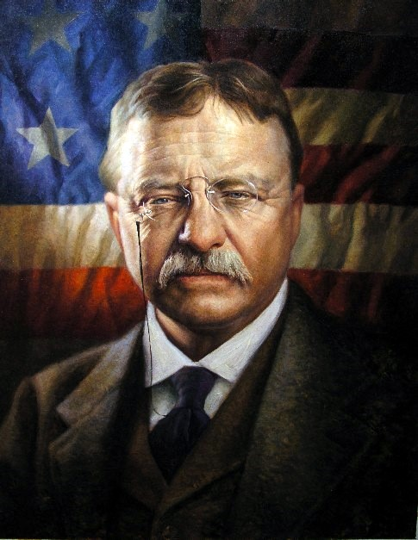
Teddy Roosevelt said…
Do what you can,
With what you have,
Where you are.

Slide 21

Enjoy the Day!

